Slide 1


Slide 2
TECHNICAL SKILLING - 4 (IT VENTURE MANAGEMENT)
FACULTY BY :-ASS PROFF ANURADHA NANDULA
BY
K Sriman Narayana(2110030122)
G Sri Charan(2110030339)
G Chaitanya Reddy(2110030309)
A Lakshmi Narayana(2110030339)

Slide 3
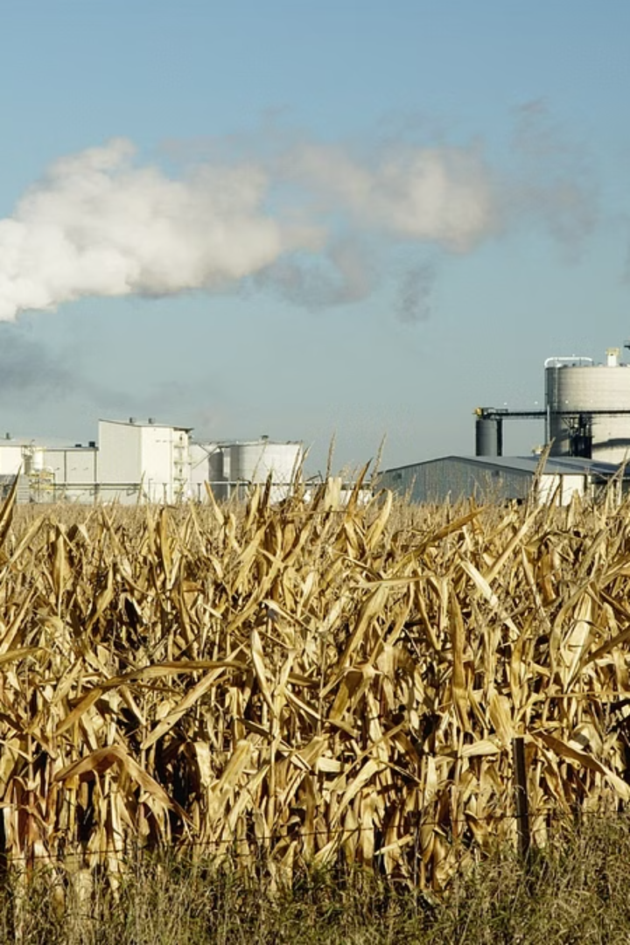


Introduction to Ethanol Fuels
Ethanol is a renewable, domestically-produced biofuel that can be blended with gasoline to power vehicles. E20 refers to a fuel blend containing 20% ethanol and 80% gasoline, offering an eco-friendly alternative to traditional petroleum-based fuels.
by KSN'S LOGISTICS

Slide 4
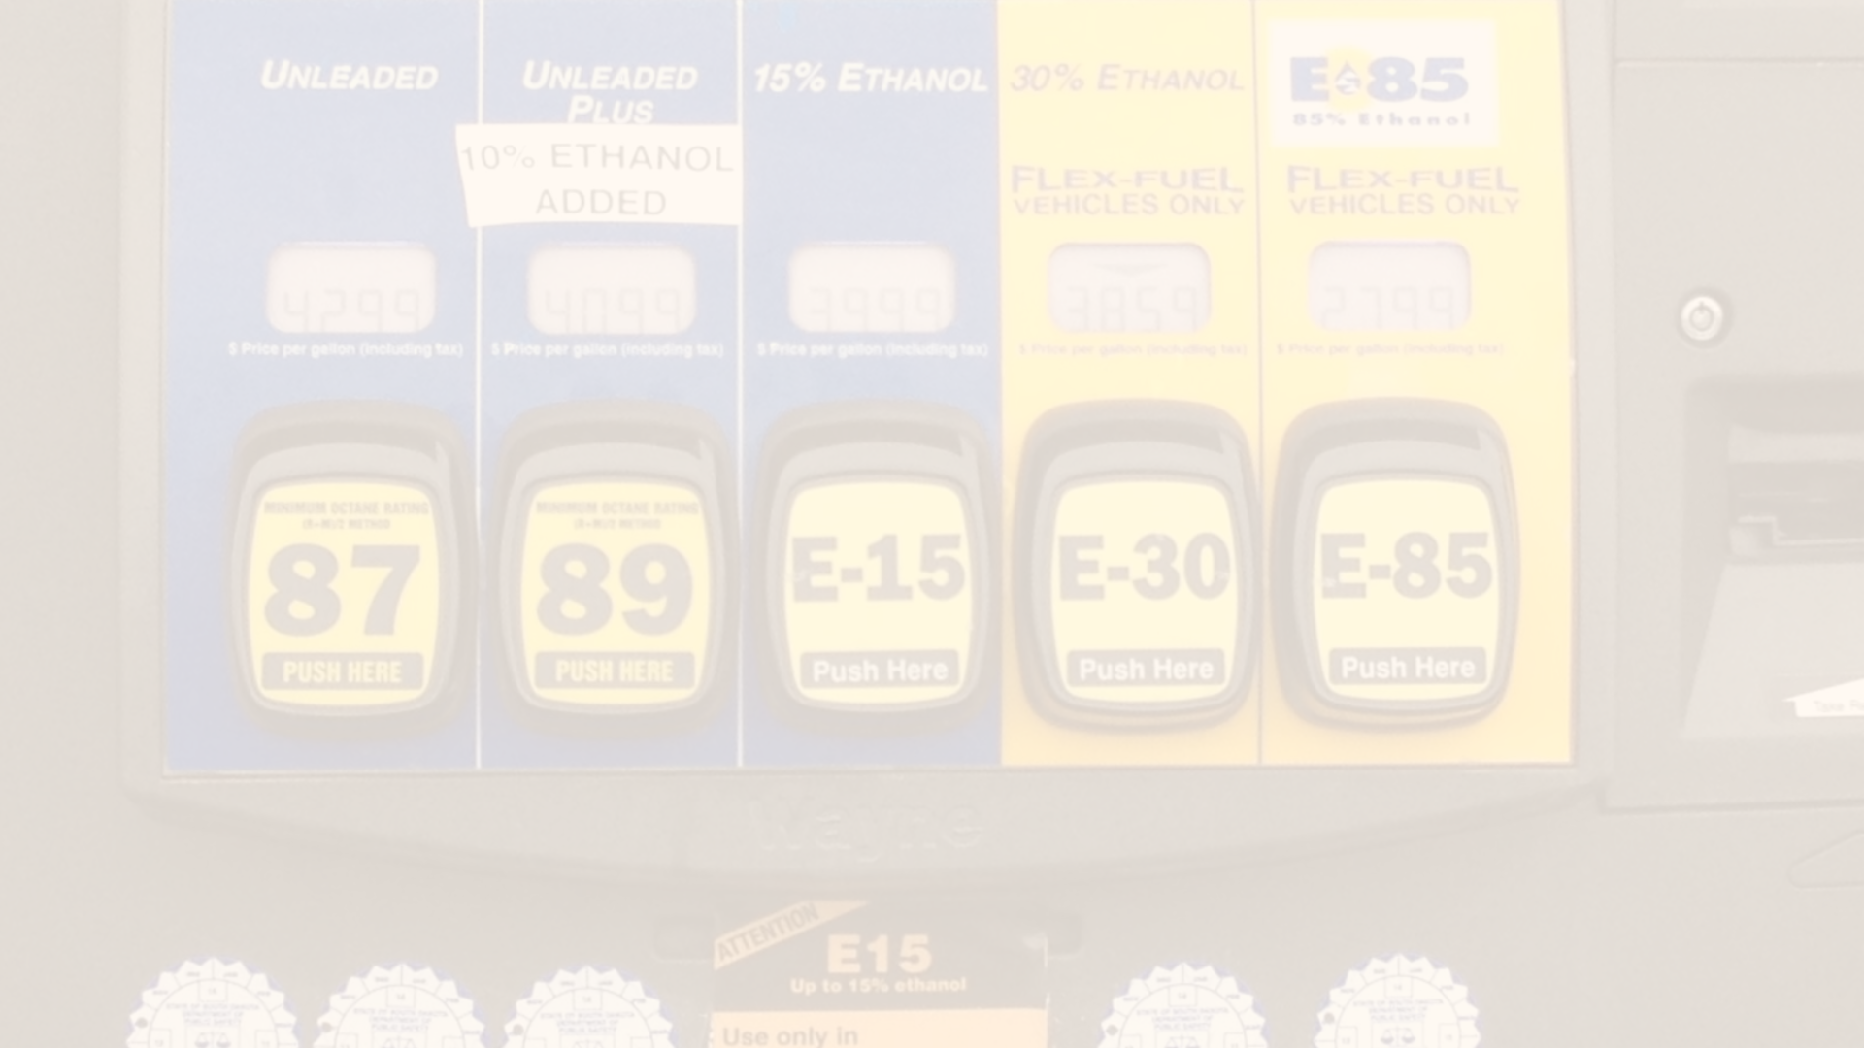
What is E20?
E20 is a blend of 20% ethanol and 80% conventional gasoline. This ethanol-gasoline mixture provides improved engine performance, increased fuel efficiency, and reduced greenhouse gas emissions compared to standard gasoline. E20 is compatible with the majority of modern vehicles on the road today.

Slide 5

Benefits of E20
1
Reduced Emissions
2
Increased Octane
E20 burns cleaner than regular gasoline, lowering tailpipe emissions of carbon monoxide, particulate matter, and other pollutants.
The higher octane rating of ethanol improves engine performance and prevents knocking or pinging.
3
Domestic Production
Ethanol is produced from renewable domestic resources like corn and other crops, reducing reliance on imported oil.

Slide 6
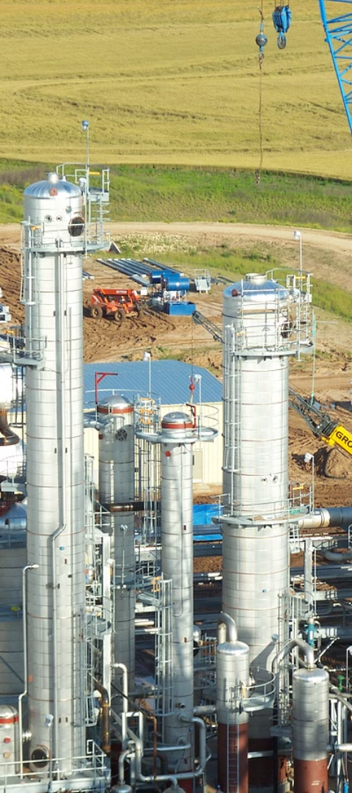
Ethanol Production Process
1
Feedstock Cultivation
Ethanol is primarily produced from corn, sugarcane, or other starch and sugar-rich crops.
2
Fermentation
The feedstock is fermented using yeast to convert the sugars into ethanol.
3
Distillation
The fermented mixture is distilled to separate and purify the ethanol from the other byproducts.

Slide 7
Compatibility of E20 with Vehicles
Approved Vehicles
Older Vehicles
Maintenance
E20 is approved for use in all flex-fuel vehicles (FFVs) and many newer conventional gasoline vehicles.
Drivers of older vehicles should consult their owner's manual before using E20, as it may not be compatible.
Proper maintenance, such as regular fuel filter changes, is important when using E20 in any vehicle.

Slide 8
Environmental Impact of E20
Reduced Greenhouse Gases
Biodegradable
E20 can reduce lifecycle greenhouse gas emissions by up to 2% compared to standard gasoline.
Ethanol is a renewable, biodegradable fuel that does not persist in the environment like fossil fuels.
Sustainable Production
Reduced Fossil Fuel Dependence
Ethanol production uses sustainable agricultural practices and renewable feedstocks to minimize environmental impact.
Increased use of E20 can help reduce reliance on non-renewable, imported fossil fuels.

Slide 9




Regulations and Standards for E20
Fuel Specifications
Retail Labeling
Vehicle Warranties
E20 must meet strict quality and performance standards set by the ASTM International.
Fuel dispensers offering E20 must be clearly labeled to inform consumers.
Most major automakers approve the use of E20 in their newer vehicle models.

Slide 10




Conclusion and Future Outlook
Renewable
Eco-Friendly
High Performance
Promising Future
Ethanol is a sustainable, domestically-produced fuel that can reduce reliance on fossil fuels.
E20 burns cleaner than gasoline, lowering tailpipe emissions and improving air quality.
The higher octane of E20 can enhance engine power and efficiency in compatible vehicles.
As technologies and policies continue to evolve, the use of E20 and other ethanol blends is expected to grow.

Slide 11
NOW CONVERSION OF A ENGINE OR FABRICATION

Slide 12
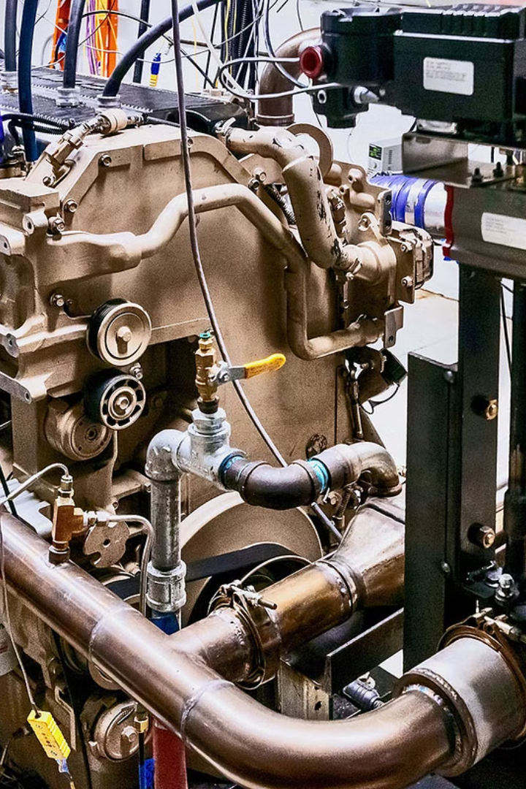

Introduction to Ethanol Engine Conversion
Converting a car engine to run on ethanol involves modifying the fuel system to accommodate higher ethanol concentrations. This conversion can significantly reduce greenhouse gas emissions.

Slide 13
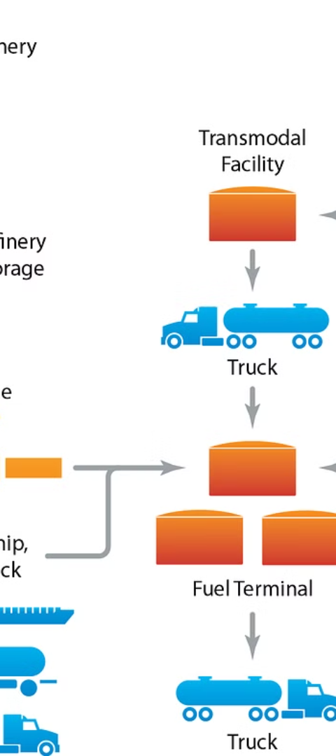
Benefits of Ethanol Fuel
1
Renewable
2
Reduced Emissions
Ethanol fuel is made from renewable sources such as corn or sugarcane.
It produces fewer greenhouse gas emissions compared to traditional gasoline.
3
Energy Security
It reduces dependence on imported oil, enhancing energy security.

Slide 14
Process of Converting a Car Engine to Run on Ethanol
Engine Modification
Adjusting Timing
Fuel Mapping Calibration
The fuel system is adjusted to handle ethanol's corrosiveness.
Optimizing spark timing to match ethanol's higher octane rating.
Reprogramming the engine control unit for efficient ethanol combustion.
Larger injectors and a higher-flow fuel pump may be required.

Slide 15

Advantages of Using Ethanol as a Fuel Source
1
Octane Rating
2
Domestic Production
Ethanol's high octane rating enhances engine efficiency.
Ethanol is often locally produced, supporting domestic economies.
3
Diverse Sources
Ethanol can be derived from various crops, promoting agricultural diversity.

Slide 16

Environmental Impact of Ethanol Fuel
Carbon Neutral
Reduced Air Pollution
Ethanol production and combustion result in near-zero net carbon emissions.
It lowers emissions of harmful pollutants, improving air quality.
Soil Conservation
Ethanol crops help prevent erosion and promote soil health.

Slide 17
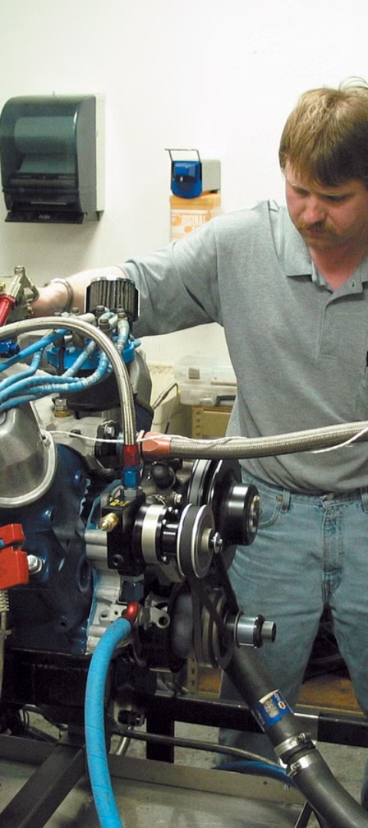



Challenges and Limitations of Ethanol Engine Conversion
Compatibility
Some older car models may face compatibility issues with ethanol.
Availability
Access to E85 or higher ethanol blends can be limited in certain regions.
Engine Wear
Ethanol's corrosive properties can accelerate engine wear over time.

Slide 18

Case Studies of Successful Ethanol Engine Conversions
1
Engineering Precision
Thorough engine modifications for seamless ethanol integration.
2
Performance Testing
Rigorous testing to ensure optimal ethanol-fueled engine performance.
3
Efficiency Enhancement
Increased fuel efficiency and reduced emissions after conversion.

Slide 19



Conclusion and Future Prospects of Ethanol Fuel
Sustainability
Technological Innovation
Global Impact
Ethanol's potential to contribute to sustainable energy solutions.
Ongoing advancements in ethanol production and utilization technologies.
Positioning ethanol as a key player in the transition to green energy.

Slide 20

WELCOME e2O

